Slide 1


SAPE: Demystifying Sub-band Aware Power Equalization
HotMobile 2026
Dingyu Zhang (JHU)*
Ish Kumar Jain (RPI)
Renjie Zhao (JHU)

Slide 2
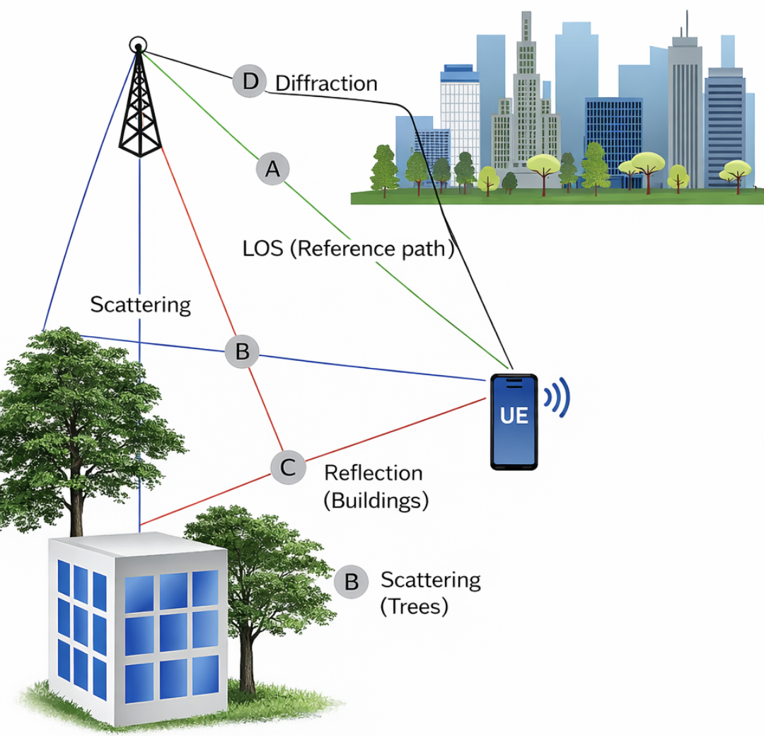
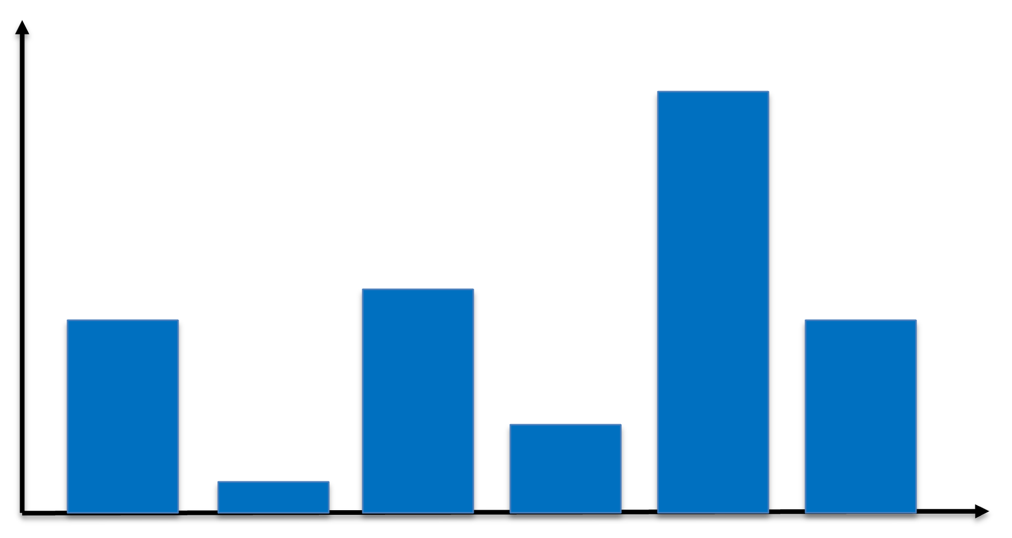
Frequency-Selective Fading
Signal Strength
Subcarriers
Notes:
Let’s look at a classical problem in wireless transmission system frequency selective fading.
When the transmitter send the signal to receiver, base station to UE in cellular downlink transmission, objects in environment cause reflection and lead the signals to arrive at receiver by different paths
With OFDM, a wideband signal is split into many subcarriers, and multipath causes some of them to experience deep fading while others remain strong.
So how to solve this problem in cellular system?

Slide 3
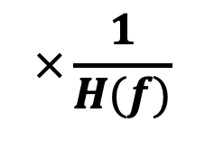
Receiver-side Equalization: A Hidden Cost
H(f)
$$×\frac{1}{H(f)}$$
Equalization compensates channel distortion
Subcarriers
Noise Floor
But amplifies noise on deep fades!!
Notes:
Multiply by the inverse of channel response
So the channel becomes flat after equalization
However, lets look at the noise floor
The deep faded subcarriers noise will be significantly amplified too
so if we look at SNR across the channel, it remain the same. SNR of the distorted ones still remains the same so in fact it will not improve the decoding performance like BLER brought by the deep fading
This brought our attention besides receiver side equalization, Can we use channel information on the transmitter side to handle this issue?
there is a traditional method waterfilling

Slide 4
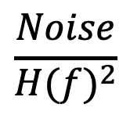
Transmitter side: Water filling
Noise-to-Channel-Gain Ratio
$$\frac{Noise}{{H(f)}^{2}}$$
Power
Subcarriers
Notes:
Same channel from previous slide, after receiver equalization, we have the normalized noise bar here which is the noise-to-channel-gain ratio
Based on the noise-to-channel-gain ratio of each subcarrier from receiver side, power will be allocated more on the strong ones while starves the deep faded ones
i.e. the taller the red bar is, the less power will be given, in some case, the bad ones will even be abandoned.
Waterfilling's assumption is to starve faded tones so it increases the likelihood that a codeword spanning all tones hits its decoding threshold

Slide 5
Why Water Filling Fails in LTE/5G
MCS 10
SNR
MCS 8
MCS 7
MCS 7
Available Power
MCS 5
Single MCS
MCS 1
Subcarriers
Notes:
But lets look at it in another form, since cellular system operates under snr so lets look at waterfilling by using SNR as the y axis.
as i mentioned, The higher the subcarrier snr is, the more power will be given to it. And the worst subcarrier will be given just a little bit power or completely abandoned
This makes sense in cellular only if each subcarrier can be independently rate-adapted, like strong subcarriers can transmit at a higher rate and weak ones at a lower rate.
Water filling need a big assumption: per-subcarrier MCS
But. Whats happeneing inLTE/5G is that it uses one MCS across whole channel
Starving weak sub-bands hurt block decoding, as you can see here, the faded one can not handler this single mcs safely under water-filling since no power will be given to it
So we propose a brand new transmitter side equalization strategy: SAPE

Slide 6
What is SAPE?
SNR
Available Power
New MCS
Single MCS
Subcarriers
Notes:
Instead of starving the weak faded ones, we decided to feed more power to the weak ones, and SAPE will flat the snr across subcarriers on the receiver side
So that when the single mcs being applied, the weak ones could still perform well and safely without hurting the decoding
Even in some cases, a higher and more aggressive MCS could be used. Our experiment results later also prove this.

Slide 7
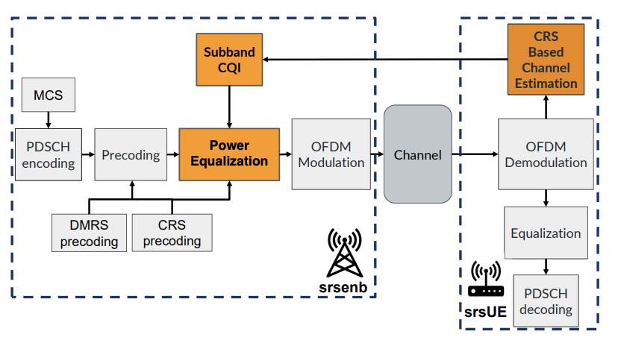
SAPE Challenges
Find protocol-compliance design so that No UE-Modification needed
Implementation challenges: SAPE on a Practical Platform
Notes:
To Design SAPE, there will be couple challenges for us
First, we have a strict no-UE-modification, fully protocol-compliance requirement. Transmitter-side power equalization requires channel knowledge, but per-subcarrier amplitude feedback would require changes to the UE and is not supported in LTE or 5G. Therefore, we restrict ourselves to existing 3GPP mechanisms and use standard subband CQI to reconstruct frequency selectivity at the transmitter.
For implementation, we need to verify this idea on a real-world practical radio platform that can support all the features needed like the subband cqi reporting.
subband CQI is optional in 3GPP and largely unsupported in real platforms. After trying multiple systems, we found that srsLTE provides only partial support, so we had to complete the entire feedback loop ourselves. And I will talk about that later.
This is what the final system diagram looks like. Suabbnd CQI will be calculate based on the reference signal CRS for channel estimation (in 5g, its called csi-rs), then we apply SAPE before OFDM, after precoding, and SAPE will be applied to both pdsch data symbols and reference signal symbols.

Slide 8
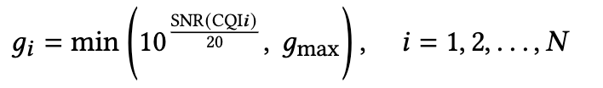
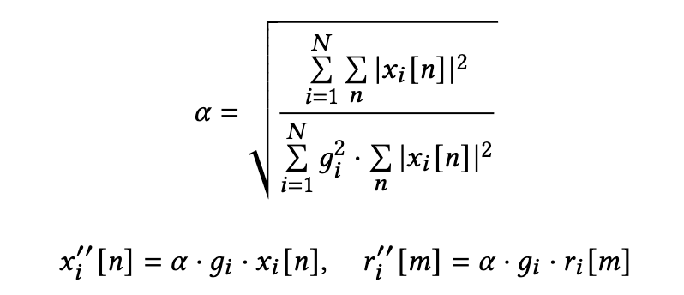
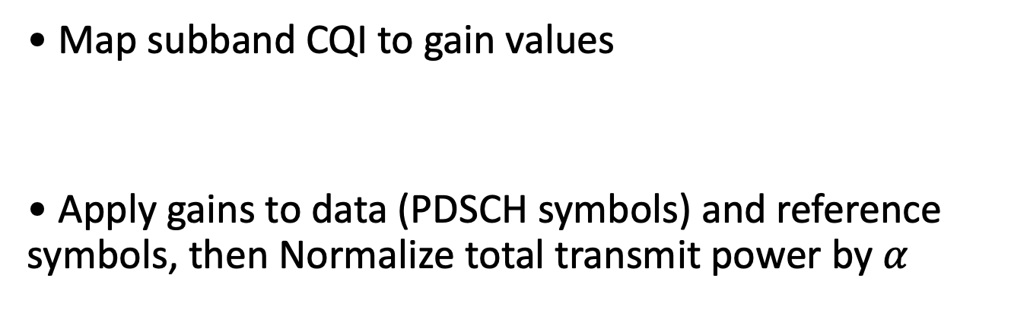
SAPE Algorithm (High Level)
• Map subband CQI to gain values
• Apply gains to data (PDSCH symbols) and reference symbols, then Normalize total transmit power by $α$
Data symbols
Reference signal symbols
Notes:
I will quickly go over what the algorithm looks like on high mathmatic level
First we need to map the cqi back to snr, thanks to some previous work, there have been some tables proposed to achieve this, and we used their table for mapping this value.
after mapping, we got subband SNR, however its in db form so we need to convert it to linear form. Then we have factor g as the power allocation factor
Once we applied g on the symbols, the total power will be changed so we have the power normalize factor alpha
Eventually after alpha and g, we got the new equalized symbols on the transmitter side

Slide 9
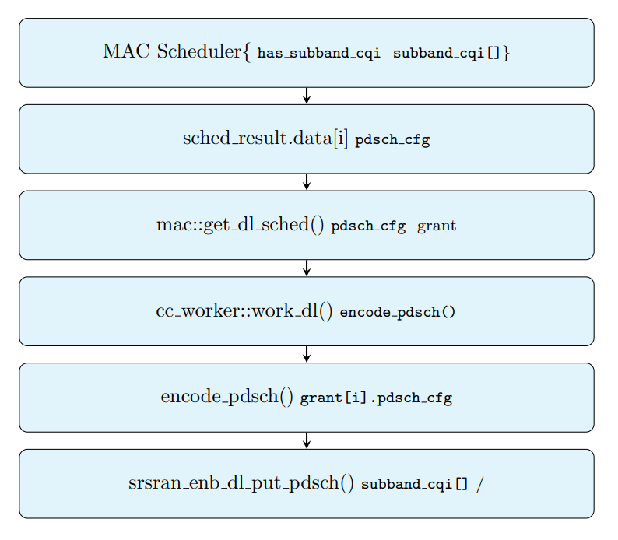
SAPE Implementation
MAC Scheduling
UE’s Channel Estimation on Sub-band Level
PUCCH
SAPE
PDSCH Encoding
Notes:
I will quickly go over how we modify the codebase in srslte to implement SAPE
In srsLTE, subband CQI is partial.
Subband CQI is partially supported in srsLTE: the feedback path exists, but subband values reuse wideband CQI.
To fully implement this, first we need to modify downlink channel estimation on UE to sub-band level and get subband CQI,
then pack the bits for Physical Uplink Control Channel (PUCCH), and pass it to transmitter,
base station unpack the bits then pass CQI values to PHY layer through different MAC schedulers to be used for SAPE which happens at PDSCH encoding

Slide 10
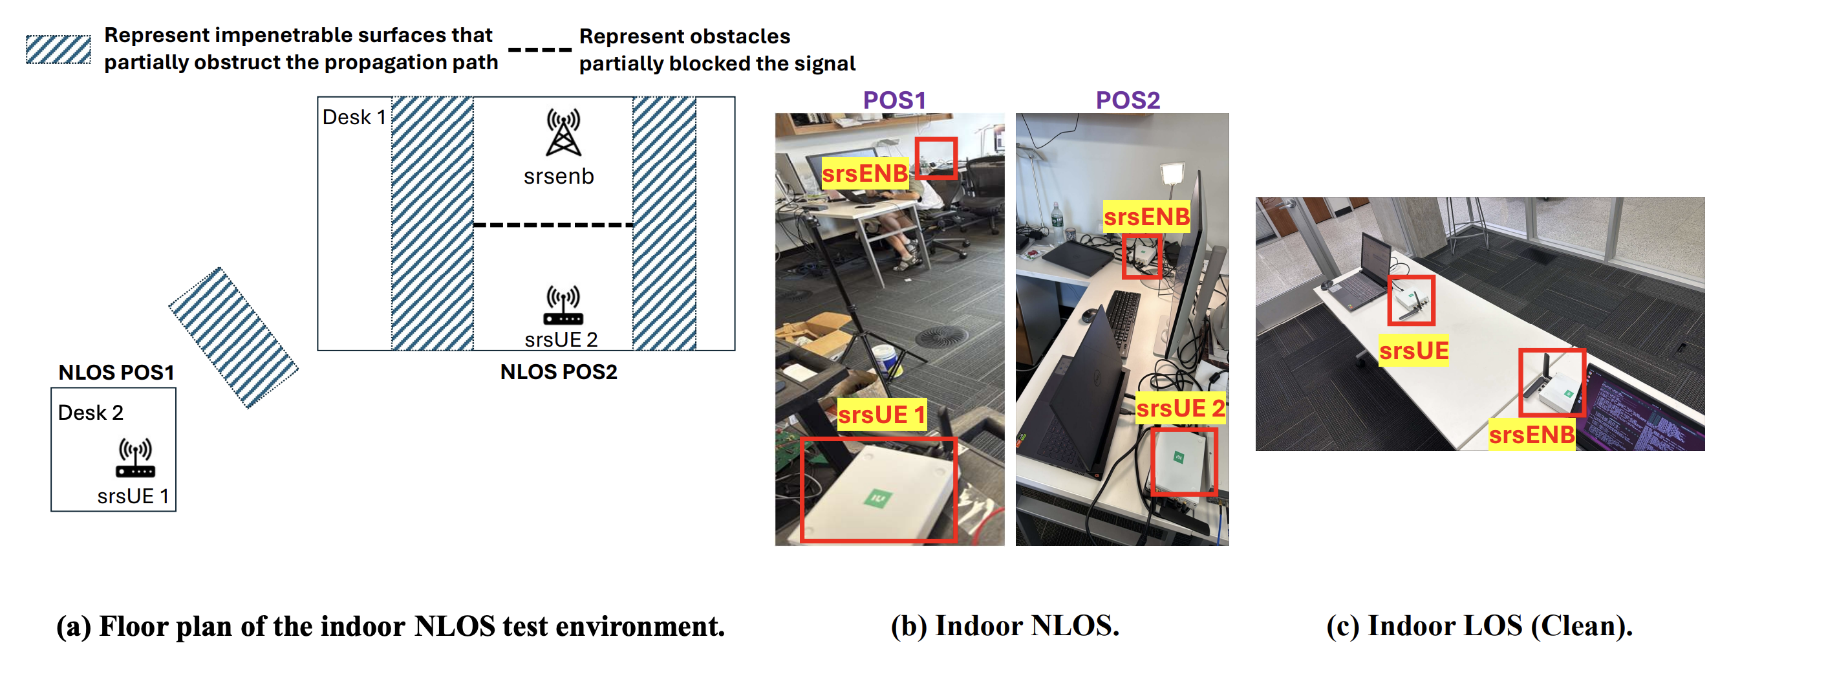
srsRAN SDR Testbed
USRP B210, LTE FDD, Band 7
Periodic wideband + subband CQI
Indoor LOS and NLOS scenarios
Notes:
This is what our setup looks like, we have NLOS which is for heavy multipath and LOS which is for no multipath to validate SAPE
Each trial transmits downlink UDP traffic using iperf with a single, fixed MCS. We compare a baseline with receiver-side equalization only against our subband Power-Equalization
Another thing I need to mention, In srsRAN, only a fixed-length implementation of reporting is supported for uplink control message feedback so we can only implement 4 subbands

Slide 11
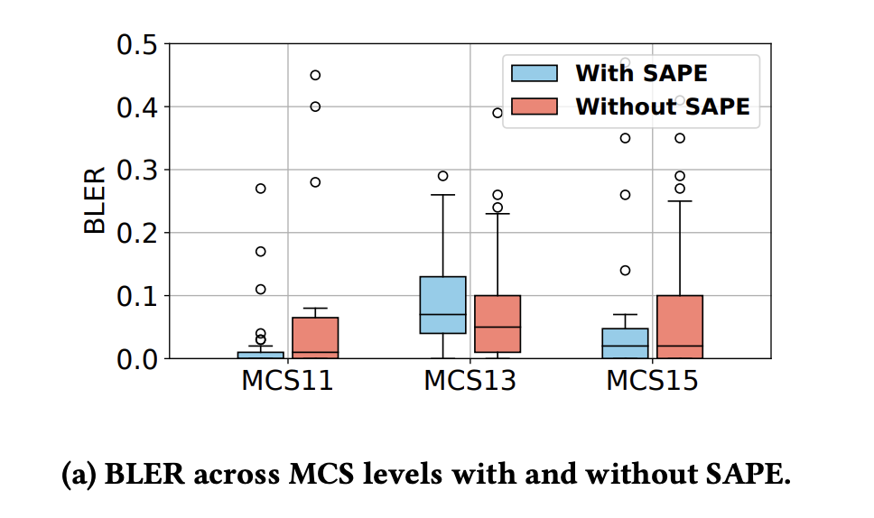
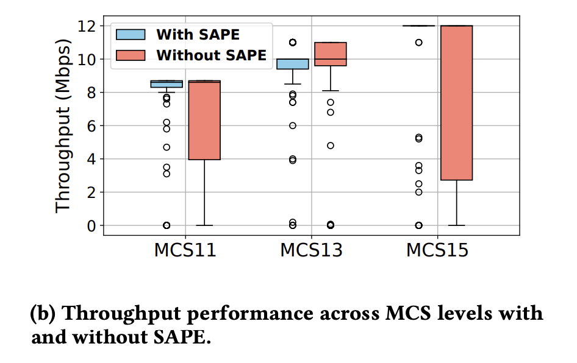
Indoor NLOS: Tail Performance Matters
Lower BLER at high percentiles
Throughput gains over 25%
Notes:
Worst 5–10% channel realizations benefit the most
For MCS 15, SAPE can achieve lower BLER at high percentiles as you can see
And improves the median throughput significantly and reduces the spread of low throughput samples.
showing that subband gain adaptation offers the most benefit when the MCS is more aggressive.
Original setup may choose a conservative MCS 13/11 for this situation while with SAPE, MCS 15 would be chosen safely instead

Slide 12
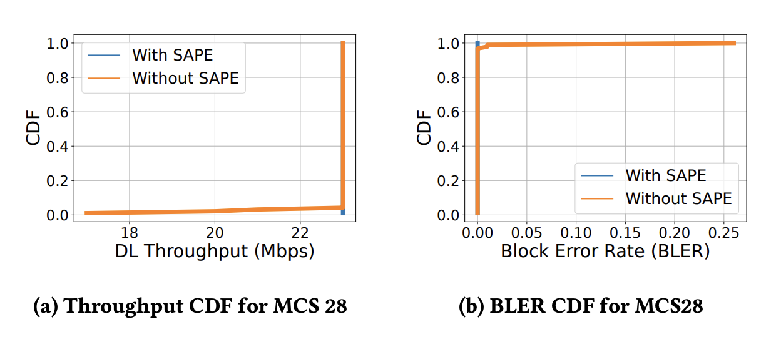
Indoor LOS: No-Regret Behavior
Flat channels see no throughput gain
No performance degradation
Slight robustness improvement
Notes:
SAPE does not hurt the performance
Say: SAPE helps when needed, disappears otherwise.

Slide 13
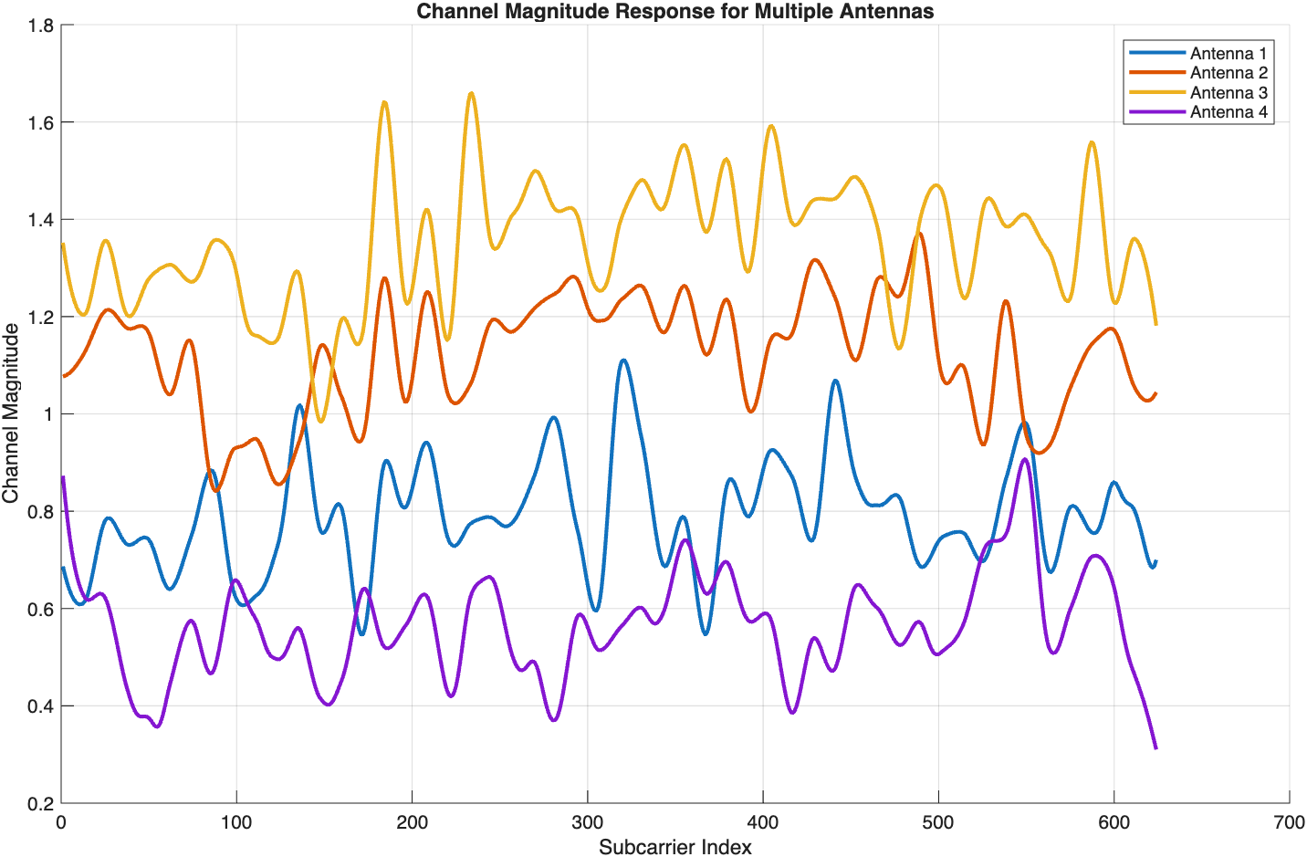
MATLAB Simulation Setup
5G NR PDSCH link-level simulation with 13 subbands
Argos real-world channel traces
Fixed MCS, no link adaptation
Notes:
As I previously mentioned, SAPE on srslte has some limitation, only 4 subbands supported and its on lte not 5g
So we added an implementation on matlab to extend the subband size to 13 and to 5g
argos can simulate mulitipath

Slide 14
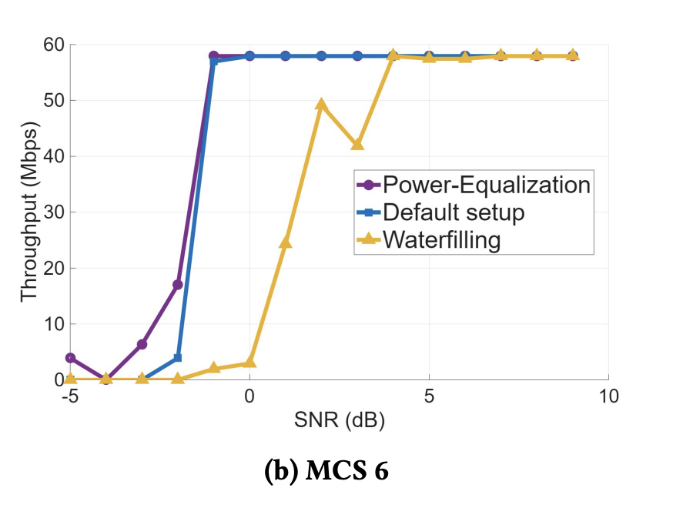
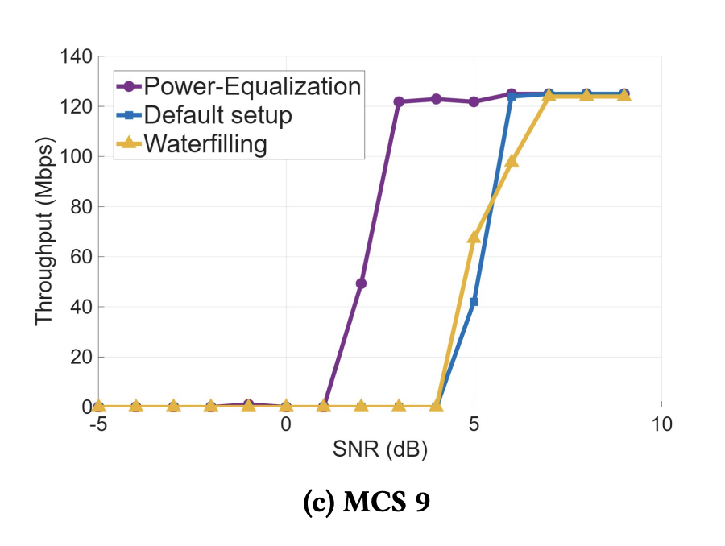
Simulation Results: Throughput vs SNR
SAPE improves throughput at high MCS
Waterfilling degrades performance
Better
Better
Notes:
SAPE performs well at high mcs again, which is mcs 9 here.
This purple line represents SAPE and it is shifting to the left. SAPE can achieve max throughput of current MCS with lower SNR required compared to default 5g setup and waterfilling
so it aligns with our results from srslte that SAPE can help the system perform better on more aggressive higher MCS when there is heavy multipath
also from both results here, we can also clearly see water-filling hurts the performance, its shifting to the right which means require higher snr to achieve maximum throughput

Slide 15
Future Directions
Subband-aware MCS selection
MU-MIMO interactions
Finer subband granularity in 5G on SDR
Open-Source GitHub Repository link: https://github.com/dyzhang1/SAPE
Notes:
To conclude, SAPE is a no-regret, protocol-compliant PHY enhancement that works in real systems today and scales naturally to 5G.
In order to fully implement it, we should also have a new MCS selection strategy like a new mapping table bc SAPE allow the system to use higher MCS than before
Thanks I am happy to take any questions

